Slide 1
2023 NSF CIRC PI Meeting
Breakout Session Report
Enhancing Reproducibility with Community Infrastructure
Organizer: David Balenson (USC-ISI)
Scribe: Johanna Cohoon (University of Utah)
Notes:
Attendees:
David Balenson, ISI
Hannah Cohoon, University of Utah
Fitz Elliott, COS
Rob Ricci, University of Utah
Joseph Konstan, University of Minnesota
Stephen Harrol, TACC
Raveen W, UT San Antonio
Joe Cavallaro, Rice
Talha Mehbob, U Mass Amherst
Shegli Fu, University of North Texas
Dasg Raj, Johns Hopkins
Amy Laviers, RAD Lab
Jennifer Hoster, Georgia Tech
Harem Deep, Texas A&M
Saurabh Bagchi, Purdue

Slide 2
Session Description
The R&D community needs to share research artifacts, including datasets, code, experimental methodologies, etc., in a way that lowers barriers to sharing and reuse. Various platforms, including NSF-funded community infrastructure such as SEARCCH, PIVOT, and CLASSNET, are working to help researchers share artifacts they produce and find artifacts produced by other researchers. How can NSF-funded community infrastructure further advance the goals of reproducibility and replicability?
This breakout session will explore the issues and challenges researchers face in capturing, packaging, sharing, finding, and reusing research artifacts. The session will discuss current initiatives, infrastructure, and incentives for sharing and reusing artifacts. It will further explore and identify other potential solutions and opportunities to increase and improve the sharing of experimentation artifacts as a solid practice in the research community.

Slide 3
Motivation
There is a need for more and high quality shared research datasets, software, and other artifacts
Datasets can include curated data from real operations or synthetically generated ones
Software can include code, scripts, configuration files, etc.
Other artifacts include papers, experiment designs/methodologies, etc.
Researchers are increasingly producing and sharing their artifacts
Conferences, workshops, and journals are encouraging and recognizing research artifacts
Practitioners are appreciating the value of research artifacts
However, there are many challenges and issues
The value and quality of artifacts is not always well understood
Artifacts can be difficult to package and share, and to find and use
It can be hard to reproduce and replicate research experiments and results
Notes:
Artifacts aren’t necessarily just prototypes; can be practically useful
Might not be worth your effort to find an artifact/dataset; they’re distributed all over, install issues, lack of response
Example of student working on a tight deadline not having time to package/share an artifact

Slide 4
Repeatability, Reproducibility, and Replicability
Repeatability (Same team, same experimental setup)
The measurement can be obtained with stated precision by the same team using the same measurement procedure, the same measuring system, under the same operating conditions, in the same location on multiple trials. For computational experiments, this means that a researcher can reliably repeat her own computation.
Reproducibility (Different team, same experimental setup)
The measurement can be obtained with stated precision by a different team using the same measurement procedure, the same measuring system, under the same operating conditions, in the same or a different location on multiple trials. For computational experiments, this means that an independent group can obtain the same result using the author’s own artifacts.
Replicability (Different team, different experimental setup)
The measurement can be obtained with stated precision by a different team, a different measuring system, in a different location on multiple trials. For computational experiments, this means that an independent group can obtain the same result using artifacts which they develop completely independently.
ACM. 2020. Artifact Review and Badging Version 1.1 - August 24, 2020 (website). https://www.acm.org/publications/policies/artifact-review-and-badgingcurrent

Slide 5
FAIR Principles
F1. (Meta)data are assigned a globally unique and persistent identifier
F2. Data are described with rich metadata (defined by R1 below)
F3. Metadata clearly and explicitly include the identifier of the data they describe
F4. (Meta)data are registered or indexed in a searchable resource
A1. (Meta)data are retrievable by their identifier using a standardised communications protocol
A1.1 The protocol is open, free, and universally implementable
A1.2 The protocol allows for an authentication and authorisation procedure, where necessary
A2. Metadata are accessible, even when the data are no longer available
I1. (Meta)data use a formal, accessible, shared, and broadly applicable language for knowledge representation.
I2. (Meta)data use vocabularies that follow FAIR principles
I3. (Meta)data include qualified references to other (meta)data
R1. (Meta)data are richly described with a plurality of accurate and relevant attributes
R1.1. (Meta)data are released with a clear and accessible data usage license
R1.2. (Meta)data are associated with detailed provenance
R1.3. (Meta)data meet domain-relevant community standards
Findable
The first step in (re)using data is to find them. Metadata and data should be easy to find for both humans and computers. Machine-readable metadata are essential for automatic discovery of datasets and services, so this is an essential component of the FAIRification process.
Accessible
Once the user finds the required data, she/he/they need to know how they can be accessed, possibly including authentication and authorization.
Interoperable
The data usually need to be integrated with other data. In addition, the data need to interoperate with applications or workflows for analysis, storage, and processing.
Reusable
The ultimate goal of FAIR is to optimize the reuse of data. To achieve this, metadata and data should be well-described so that they can be replicated and/or combined in different settings.
https://www.go-fair.org/fair-principles/
Notes:
Principles help make your object persistent

Slide 6
Some References
National Academies of Sciences, Engineering, and Medicine 2022. Fostering Responsible Computing Research: Foundations and Practices. Washington, DC: The National Academies Press. https://doi.org/10.17226/26507.
K. Keahey, J. Anderson, M. Powers and A. Cooper, "Three Pillars of Practical Reproducibility," 2023 IEEE 19th International Conference on e-Science (e-Science), Limassol, Cyprus, 2023, pp. 1-6, https://doi.org/10.1109/e-Science58273.2023.10254846.
Mark D. Wilkinson, Michel Dumontier, IJsbrand Jan Aalbersberg, et al. 2016. The FAIR Guiding Principles for scientific data management and stewardship. Scientific Data 3 (2016), 160018. https://doi.org/10.1038/sdata.2016.18
David Balenson, Terry Benzel, Eric Eide, David Emmerich, David Johnson, Jelena Mirkovic, and Laura Tinnel. 2022. Toward Findable, Accessible, Interoperable, and Reusable Cybersecurity Artifacts. In Proceedings of the 15th Workshop on Cyber Security Experimentation and Test (CSET '22). Association for Computing Machinery, New York, NY, USA, 65–70. https://doi.org/10.1145/3546096.3546104
Suneeta Mall, The 3-R’s of Data-Science: Repeatability, Reproducibility, & Replicability. https://suneeta-mall.github.io/slides/3Rs.html
Plesser HE. Reproducibility vs. Replicability: A Brief History of a Confused Terminology. Front Neuroinform. 2018;11:76. Published 2018 Jan 18. https://doi.org/10.3389/fninf.2017.00076
Christian Collberg and Todd A. Proebsting. 2016. Repeatability in Computer Systems Research. Commun. ACM 59, 3 (Feb. 2016), 62–69. https://doi.org/10.1145/2812803
Haibe-Kains, B., Adam, G.A., Hosny, A. et al. Transparency and reproducibility in artificial intelligence. Nature 586, E14–E16 (2020). https://doi.org/10.1038/s41586-020-2766-y
MANY MANY MORE!

Slide 7
Main Proposition
The community needs sustainable infrastructure and processes to support reproducibility and replicability including the sharing and reuse of curated datasets, software, and other artifacts (including a clear description of their intended uses and limitations)
This will provide researchers with:
A better understanding of the quality (and how to measure it) and limitations of artifacts
An improved capability to share and find relevant artifacts as well as knowledge and experience about their use
This, in turn, will help the community better reproduce and replicate experimental results and accumulate and advance knowledge, instead of repeating past mistakes and misunderstanding the implications of previous research results
Notes:
Did other people find the artifact useful? Could be helpful to provide

Slide 8
EXAMPLE COMMUNITY INFRASTRUCTURE for sharing artifacts and supporting reproducibility

Slide 9
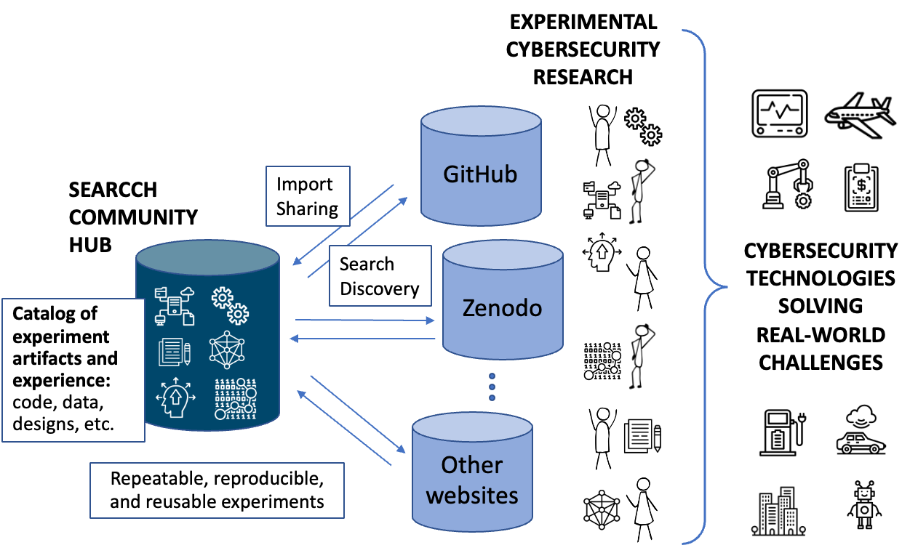
SEARCCH: Sharing Expertise and Artifacts for Reuse through Cybersecurity Community Hub
Goal: Community-driven platform lowers barrier to sharing and reusing research artifacts
Rich metadata representation enables researchers to better describe and find relevant artifacts
Import, curation, and search functions enable greater scientific quality of cybersecurity research
https://searcch.cyberexperimentation.org/
Notes:
Goes to DOI, heuristically identify data, give you a view and then make available to others
Robust search
Able to rate and review artifacts

Slide 10
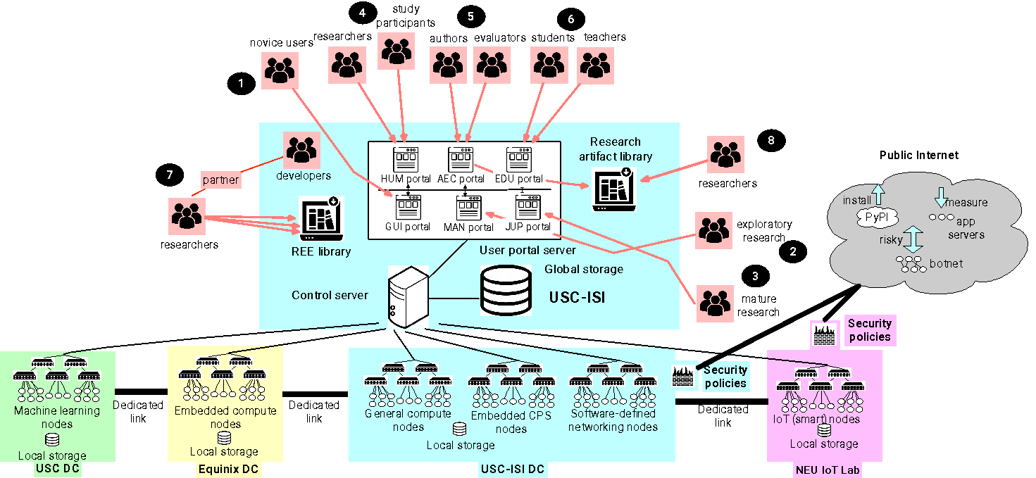
SPHERE: Security and Privacy Heterogeneous Environment for Reproducible Experimentation
Goal: Provide the cybersecurity and privacy research community with a common, rich, representative research infrastructure, which meets the needs across all members of the community, and facilitates reproducible science
Diverse hardware to support diverse research needs (85% of today's publications): General and embedded compute notes with trusted hardware, PLCs and IoT devices, programmable switches and NICs, GPU-equipped nodes
Six user portals supporting: Exploratory research (MAN), novice users (GUI), mature research (JUP), use in classes (EDU), use in human user studies (HUM), use for artifact evaluation (AEC)
Flexible security policies: Full isolation, measurement research, software download, risky experiments with malware
Libraries of artifacts: Realistic experiment environments and other artifacts, easy reuse on SPHERE
https://sphere-project.net/
Notes:
In addition to diverse hardware and portals, has libraries of artifacts. Realistic experimentation environments for researchers to use; gets captured and cataloged for reuse
Will work with artifact evaluation committees to facilitate interaction between evaluators and submitters

Slide 11
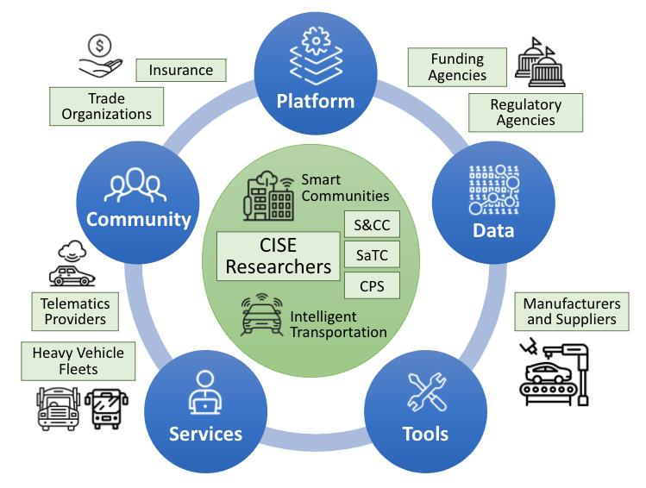
PIVOT: Catalyzing the Community Around Collection and Sharing of Automotive Research Datasets
GOAL: Develop a communit platform to catalyze the production and consumption of automotive and heavy-duty datasets and tools to support research in vehicle system cybersecurity, intelligent transportation, smart & connected communities
FIVE PILLARS
Platform: Robust and reliable hardware and software upon which the system runs
Data: Curation and sharing of data and contextual information
Tools: Common software-based tools to collect, transform, combine, filter, and visualize the data
Services: Researcher centric services for sharing, securing, and evaluating datasets – plus privacy services
Community: Outreach and engagement to improve the data utility using design feedback mechanisms
Example Datasets
ORNL ROAD dataset
Korea University HCRL Datasets
Bosch SynCAN (for CANet)
CSU Heavy Truck Datasets
Geotab telematics data and Altitude analytics platform
US DOT Public Data Portal
SmartColumbus Datasets
Wyoming DOT CV Pilot
Potential Applications
Cybersecurity and safety
Vehicle performance and maintenance
Transportation and fleet management
Smart cities and communities
NSF research programs
+
https://www.pivot-auto.org/

Slide 12
CLASSNET: Community Labeling and Sharing of Security and Networking Test datasets
GOAL: Provide new labeled datasets to enable new network security research and support machine learning
Dataset portal: New dataset portal https://comunda.isi.edu to help researchers find data providers and datasets
Diverse labels: Labels for datasets provided by multiple researchers, allowing comparing interpretations
Diverse pathways to dataset: Multiple access paths to data: download, cloud, remote access, code-to-data
Continuous and curated datasets: Plus, your contributions. Want data? Have data to share? See https://comunda.isi.edu or talk to us!
Researcher workflow
Provider workflow
https://ant.isi.edu/classnet/
Notes:
Supported by DOHS previously
Data becomes stale the moment it’s shared

Slide 13
Many others presented during this PI meeting
Highlight presentations
Posters
Notes:
Supported by DOHS previously
Data becomes stale the moment it’s shared

Slide 14
DISCUSSION
Notes:
Prior four slides were examples of infrastructure for reproducibility

Slide 15
Discussion Questions
What are important challenges?
Are there promising directions to addressing them?
Notes:
Shared David’s point of view in prior slides

Slide 16
General theme: snapshots of environments are necessary for reproducibility and replicability
Includes datasets and software mentioned above
But also many other factors that can impact a research experiment

Slide 17
Challenge: Uncertainty about how long artifacts for reproducibility should (or could) be functional
Capturing versions, environments, etc. is necessary for reproducible artifacts
How long should researchers ensure those artifacts are reusable?
2 years? 3 years? 5 years? Likely depends on the project
Reproducibility facilitated by creating a snapshot of full environment
Should something that aims to support reproducibility have a longer lifetime?
HPC machines change every few years making some computational reproducibility not really possible
Testbeds can hold onto machines for “past the time they’re interesting” so that they can enable reproducibility
Old media types like tapes still have the hardware hanging around

Slide 18
Challenge: Reproducibility differs project to project/field to field and we need standards
Simulations may operate differently on different architectures, so capturing data about the experiment is important
There may be limited control over environments
e.g. RF interference, dependencies
Non-determinism in experiments is a challenge
e.g. randomness, human subjects
Providers should communicate expectations re: the three R’s to users
Some work (e.g. exploratory work) is novel and innovative enough that we don’t need to worry about reproducibility, right now
Different research areas (e.g. recommender systems) have different standards for what is good/bad replicability (some have no standards)
How do medical fields and physicists define reproducibility?

Slide 19
Challenge: Getting the environment to run an experiment and getting all details is almost always impossible
Have to capture hardware and environmental information
Papers don’t have enough information
Getting others’ software can be difficult
Even if you have it, you might not be able to run it for various reasons
E.g., lacking skill/domain expertise
Architectures are changing
Make it easy for others to reproduce or replicate your environment
Capture/snapshot the experiment
Want elements of experiments to be included in a manifest
Maybe these issues mean you replicate rather than reproduce

Slide 20
Opportunity: Changing our publishing model to better support reproducibility (1 of 2)
Change probably won’t come unless top publication venues prioritize reproducibility
Could do prereg as a publishing model (but it’s not super popular)
Embrace “Open Science” principles
Full transparency from the start
Allows others to review
Keep you honest
Center for Open Science (COS) (Fitz Elliott was in the room)
Registered reports - peer review before results are known
Open data, open sharing, open materials
Guarantees for uninteresting results (as long as pre-register) (NOTE: LASER Workshop)
Work with journals and conferences to push these ideas forward
Any examples in engineering? CS probably looks more like engr than medical
Many conferences encouraging artifacts, moving towards required
Not all authors are able to share artifacts (IP, privacy, classified)

Slide 21
Opportunity: Changing our publishing model to better support reproducibility (2 of 2)
Conferences can be “paper factories” with too many papers
Fewer papers at these venues and more in journals?
Authors need to present a paper to be able to attend the conference
Change conferences to be more about “conferring”
Inverted classroom model
Pre-publish paper and video
Short video “highlight” at conference
Then Q&A, discussion, and/or panel at conference (can do groups of papers)
Keeps value of socializing at the conference
By the time of a conference, the work may be out of date and the audience is already familiar with it

Slide 22
Opportunity: NSF/funders encourage sharing and reuse
(Further) encourage use of existing NSF infrastructure (SEE NEXT SLIDE)
Ask proposers to say why they can’t use them
Ask proposer what reproducibility means to them/what will it look like
Ask proposer to provide an assessment research infrastructure in their area
Including reproducibility and artifacts
May require a supplemental document
Broaden data management plan to address this
Require a seperate “infrastructure and artifact sharing and reuse plan”
Need panelists to pay attention to this too
Enforcement can be a challenge!
Researchers may not share their data/code even when they say they will

Slide 23
E.g., Recent SaTC Solicitation
ACCESS TO EXPERIMENTAL RESEARCH INFRASTRUCTURE
PIs may consider utilizing NSF-supported research infrastructure (such as the Platforms for Advanced Wireless Research, FABRIC, Chameleon, CloudLab) when formulating their research plans and submitting proposals. Descriptions of the capabilities of each system and their availability can be found at their websites: https://advancedwireless.org/, https://fabric-testbed.net/, https://www.chameleoncloud.org/, https://cloudlab.us/.

Slide 24
Opportunity: Engage the community
Run NSF workshop in the topics
Also broader community workshops: e.g. Dagstuhl, Japanese equivalent
Find champions who can lead disciplines toward reproducibility
Leverage researchers in this area
Ron Boisvert, NIST
Jack Davidson, UVA
Victoria Stodden, USC
Brian Nosek, UVA
Eric Eide, Utah
MANY OTHERS

Slide 25
Opportunity: Create a directory of infrastructure to help find artifacts, tools, and processes for reproducibility
Virtual Organization (VO)
Well-trained AI to automagically find and ingest artifacts
(Existing infrastructure such as SEARCCH, SPHERE, CLASSNET, and PIVOT)

Slide 26
Debate: If you publish, does that mean you specifically want to share and not keep work private?
Not necessarily
Interest in tech transfer/commercialization ⇒ IP
Mixture between publishing/patenting gets blurry and tricky

Slide 27
Miscellaneous Items
ACM moving to open access
IEEE Board of Governors initiative on reproducibility
Saurabh Bagchi part of the committee
If you can’t repeat your own work, it’s probably not replicable
Can look at other science domains and how they do reproducibility

Slide 28
Participants
David Balenson, USC-ISI (Organizer)
Hannah Cohoon, University of Utah (Scribe)
Fitz Elliott, COS
Rob Ricci, University of Utah
Joseph Konstan, University of Minnesota
Stephen Harrol, TACC
Raveen W, UT San Antonio
Joe Cavallaro, Rice
Talha Mehbob, U Mass Amherst
Shegli Fu, University of North Texas
Dasg Raj, Johns Hopkins
Amy Laviers, RAD Lab
Jennifer Hoster, Georgia Tech
Harem Deep, Texas A&M (affiliation is correct, need to confirm name)
Saurabh Bagchi, Purdue

