Slide 1
CCRI: ENS: Enhancement of Trust-Hub, a Web-based Portal to support the Cybersecurity Research Community
Mark Tehranipoor
Domenic Forte
Farinaz Koushanfar
Ramesh Karri
Notes:
Let me begin by thanking NSF and the organizers for putting on this outstanding event. It’s wonderful to hear about all the research infrastructure, services, and engagement efforts from the program’s PIs.
I’m Domenic Forte, a Professor in the ECE department at the University of Florida and the Associate Director of the Florida Institute for National Security.
I’ll be making this presentation on behalf of the PI, Mark Tehranipoor – He became our department’s chair last year and had some conflicts which prevented him from attending the CIRC meeting this week.
I’ll also be presenting the contributions from the other Co-PIs – Professor Farinaz Koushanfar of UC San Diego and Professor Ramesh Karri of NYU.

Slide 2
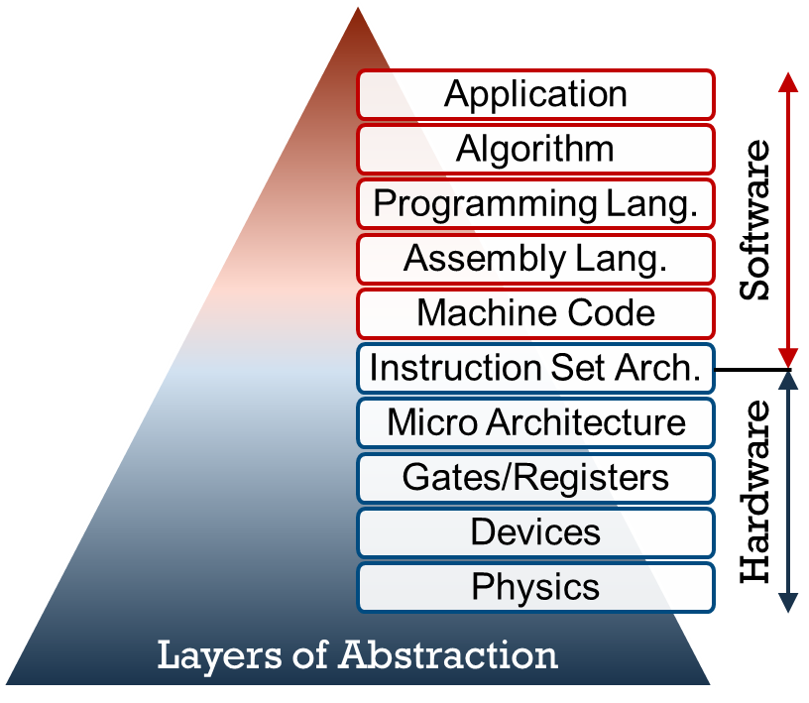
Why Hardware Security and Trust (HS&T)?
Resilience to software vulnerabilities
Secure cryptographic operations and sensitive data
Guarantee hardware performs as intended, without being compromised in a global supply chain and free from vulnerabilities
Protect against physical attacks
Prevent counterfeiting and Intellectual Property (IP) theft
Challenge: Benchmarking in hardware security is challenging, i.e., lack of standard metrics, diverse threat landscape, limited publicly available data, etc.
Notes:
The research infrastructure that we’ve been developing and now enhancing is in support of the hardware security and trust community.
Hardware security and trust is an ever-growing area of importance in system security.
With hardware being at a lower level of abstraction than software, creating hardware roots or trust can make systems resilient to software vulnerabilities.
Nevertheless, hardware itself may be vulnerable to threats associated with the supply chain, e.g., so-called counterfeits and hardware Trojans.
Physical attacks such as a side-channel analysis, fault injection, optical probing, and circuit edit
And intellectual property theft
A significant barrier to progress in the area early on was benchmarking and comparison of results, due to lack of standardization, the diverse and changing threat landscape, and limited publicly available hardware designs.

Slide 3
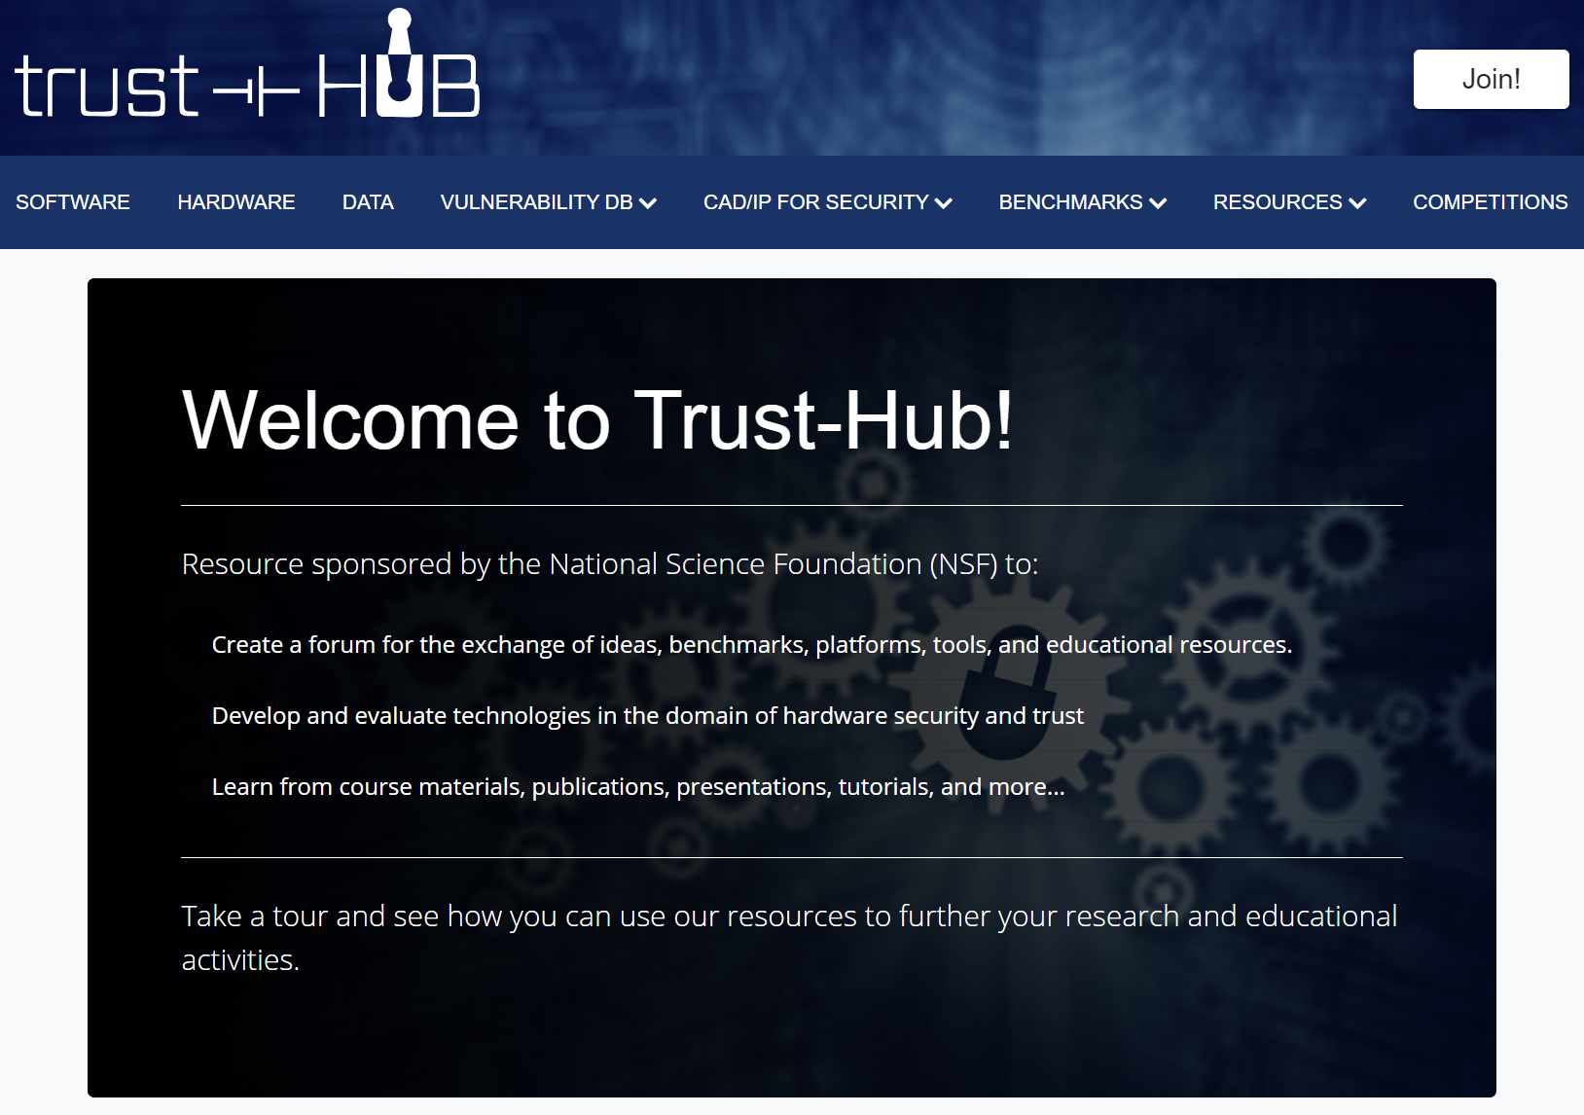
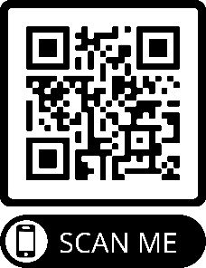
What is Trust-Hub?
Website Stats (Jul 20 – Mar 23)
44 users per day
Users from 147 countries
Top 10: USA, China, Indonesia, India, Japan, South Korea, Germany, Taiwan, Hong Kong, Singapore
36 downloads per day
Top Categories - items
Trojan Benchmarks
Datasets – FPIC and FICS-PCB
Obfuscation Benchmarks
Software – SynthGen and PUFMeter
Notes:
Our infrastructure, Trust-Hub, was proposed to address this by creating a repository for not only hardware security benchmarks, datasets and metrics, but also tools, competitions, and platforms that facilitate the spread of knowledge and result in the creations of even more benchmarks.
Something about stats…

Slide 4
History of Trust-Hub and Major Contributions
CI-ADDO-NEW: Trust-Hub: Design of Trust Benchmarks, Hardware Validation Platforms and a Web-Based Dissemination Portal
CI-EN: Trust-Hub: Development of Benchmarks, Metrics, and Validation Platforms for Hardware Security, and a Web-based Dissemination Portal
CCRI: ENS: Enhancement of Trust-Hub, a Web-based Portal to support the Cybersecurity Research Community
(This Iteration of Project)
2010
2015
2020
PUFMeter v1.0: A Property Testing Tool for Assessing the Robustness of PUFs to ML Attacks
Hardware Obfuscation Benchmarks and Competition
Hardware Trojan Support Tool Suite and Hardware Trojan Benchmarks
Counterfeit-ic.org Data Collection and Repository Development
PUF and Counterfeit IC Measurement Datasets
See
Remaining
Slides
Tutorials: Hardware Trojan Insertion on FPGAs, ASIC Data Collection Using FPGA Interface, Hardware Trojan Insertion on WARP
Trust-Hub has played a major role in the HS&T community’s growth
Notes:
Trust-Hub was started by 3 PIs in 2010 from support by NSF. It mainly consisted of a website with hardware tutorials and most importantly hardware Trojan benchmarks. These benchmarks were a major landmark for the community and have been cited more than 1000 times.
In 2015, Trust-hub was again funded by NSF where its group of PIs expanded, its website was further enhanced and its mission was extended beyond hardware Trojans to create counterfeit datasets, hardware obfuscation benchmarks, and PUF assessment tools like PUFMeter. We also created a social media presence with a Facebook group that today contains 500+ members.
Nevertheless, contributions to Trust-hub in the first 2 iterations of the project were all made by the PIs themselves. The main goals of this final ENS project are
To create a sustainable effort by obtaining contributions from wider community (C), including colleagues in both academia and industry
To cover the remaining gaps in Trust-hub’s benchmarking, tools, and competitions and

Slide 5
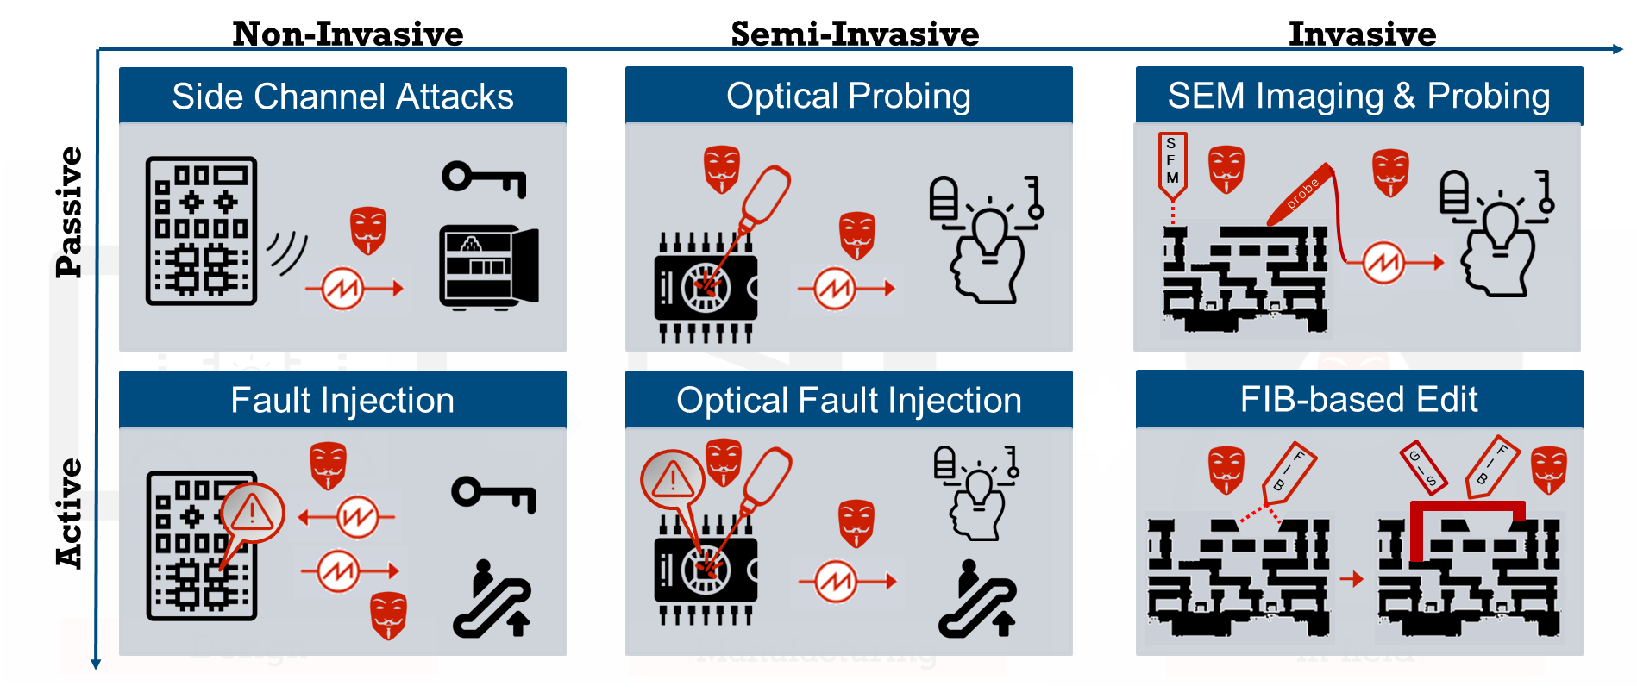
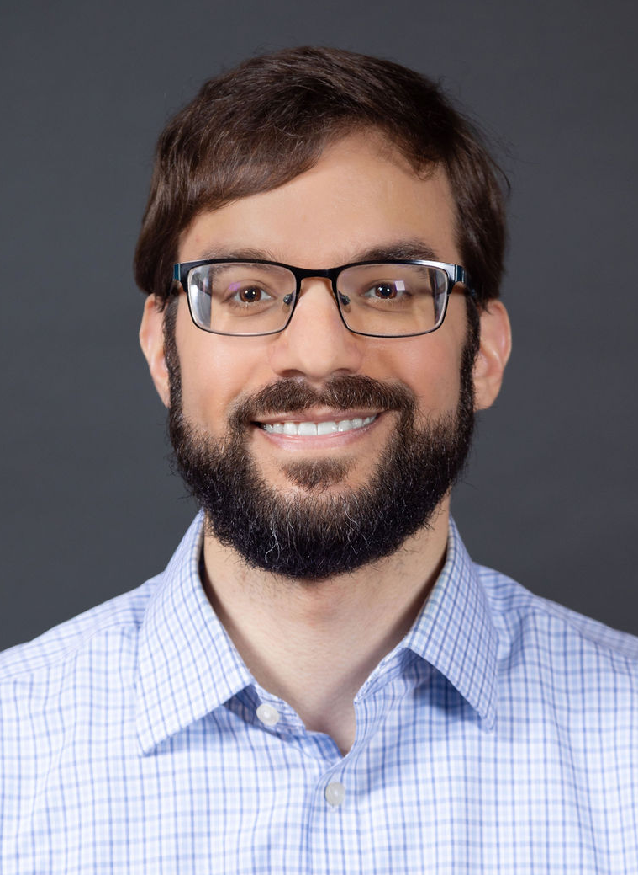
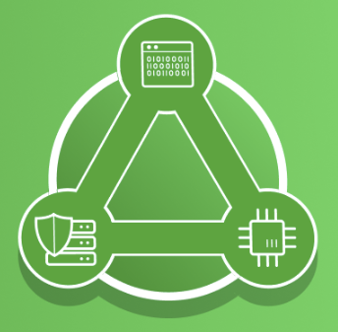
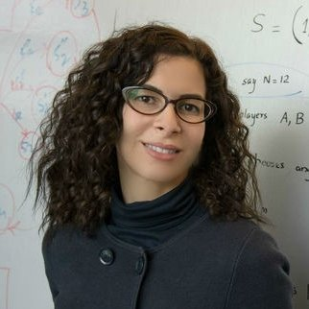
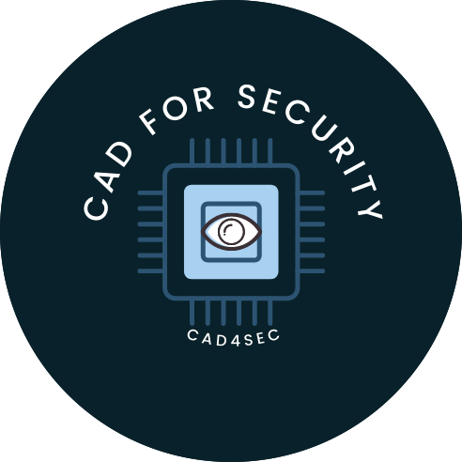
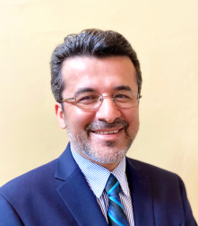
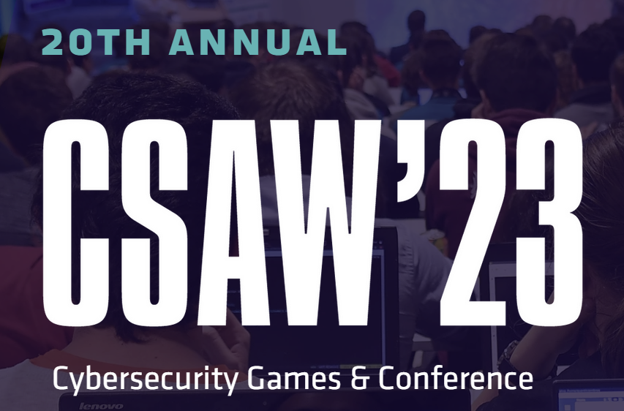
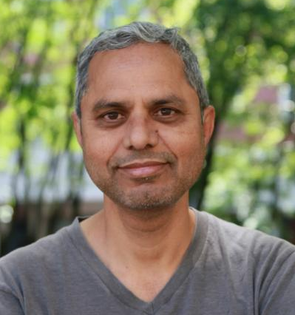
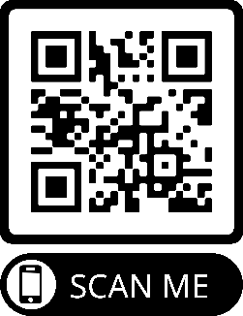
CCRI: ENS: Enhancement Tasks and Leads
1. Physical SoC Security Tools & Benchmarking
2. AI Security Tools & Benchmarking
Lead: Domenic Forte
Lead: Farinaz Koushanfar
3. RTL/Gate SoC CAD Tools & Benchmarking
4. Cybersecurity Games & Conference (CSAW)
Lead: Mark Tehranipoor
Lead: Ramesh Karri
Notes:
To this end, we have 4 PIs who are each leading a task:
Task 1, which is led by me, focuses on the area of physical attacks
Task 2 focuses on AI security tools and benchmarks. It is led by Dr. Koushanfar
In task 3, Dr. Tehranipoor is leading an effort to expand beyond IP-level tools, benchmarks, etc. towards system-on-chip (SoC)
Finally, Dr. Karri is leading the competitions effort by organizing the annual CSAW event

Slide 6
List of Tools in Tasks 1, 2, and 3
Task 1 - Physical SoC Security Tools & Benchmarking
Task 2 - AI Security Tools & Benchmarking
 | Quantity | Team | Community | % Complete
Invasive Tools | 6 | ✓ | ✓ | 85%
RASC | 4+1 | ✓ |  | 75%
RE Datasets | 9 | ✓ | ✓ | 100%
CAPEC | 6 | ✓ |  | 85%
 | Quantity | Team | Community | % Complete
NAS | 2 | ✓ | ✓ | 100%
Dataset Augmentation | 2 | ✓ | ✓ | 75%
PUFMeter v2.0 | 1 | ✓ | ✓ | 75%
Task 3 - RTL/Gate SoC CAD Tools & Benchmarking
Other
 | Quantity | Team | Community | % Complete
CAD Tools Catalog | 60+ | ✓ | ✓ | 100%
Security IPs Catalog | 50+ | ✓ | ✓ | 100%
MEXT-SE | 1 |  | ✓ | 100%
SynthGen | 3 | ✓ |  | 67%
 | Quantity | Team | Community | % Complete
Vulnerability Database | 23 | ✓ | ✓ | 90%
Vulnerability Benchmarks | 6 | ✓ | ✓ | 75%
Security Properties/Rules | 100+ | ✓ | ✓ | 100%
Notes:
We are in the final year of this ENS project, but have already delivered more than the previous 2 projects combined. This is in part because we’ve solicited more contributions from the community.
As part of task 1, we’ve created 6 new tools to assess and mitigate physical attacks most of which are already uploaded to Trust-hub. We’ve also created new side channel and reverse engineering datasets for the community. Finally, we developed new and much needed entries on 6 physical attacks to be added to MITRE’s CAPEC.
Task 2 has resulted in 2 new neural architectural search approaches which design and optimize MLPs for side channel assessment and network intrusion detection. Using datasets collected in Task 1, GAN-based data augmentations techniques were developed to create even more datasets. We’ve also been expanding the PUFMeter tool to assess the vulnerability of analog PUFs to ML attacks.
Task 3 has resulted in an SoC vulnerability database, 6 new benchmarks, and security rules database with more than 100 rules!
We’ve also had some contributions in other areas, including CAD tool and Security IP catalogs with entries from almost community members. The MeXT-SE can generate platform-independent secure multi-processor systems while SynthGen can create arbitrary numbers of hardware benchmarks.

Slide 7
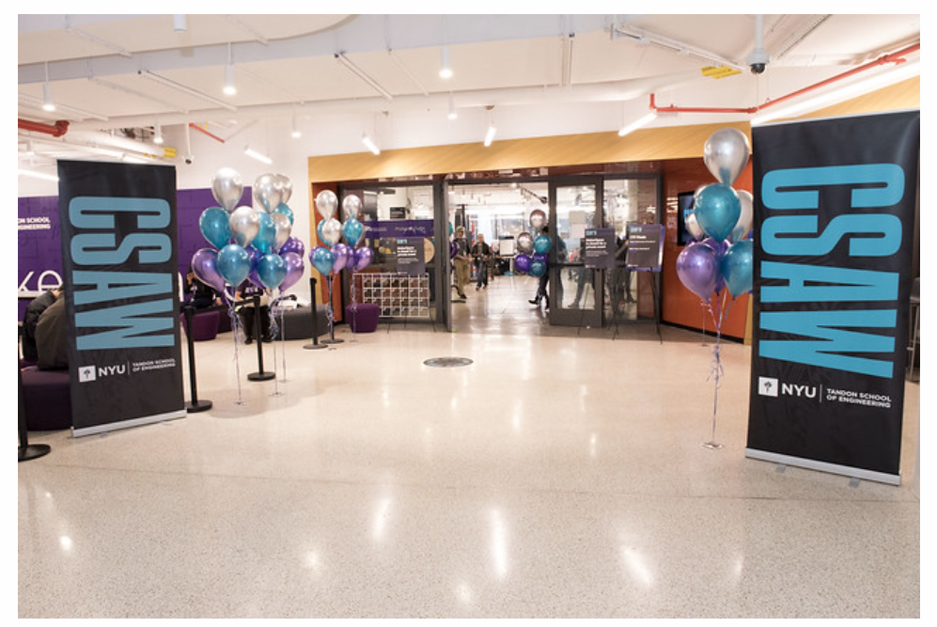
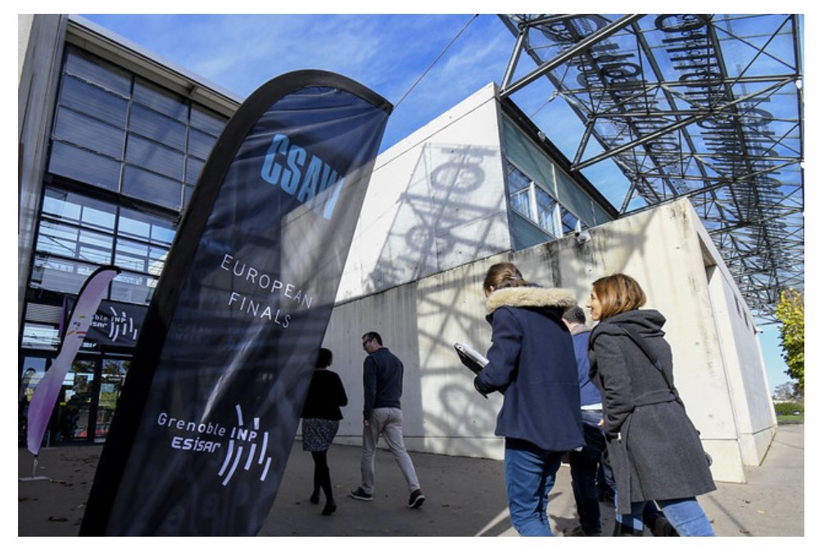
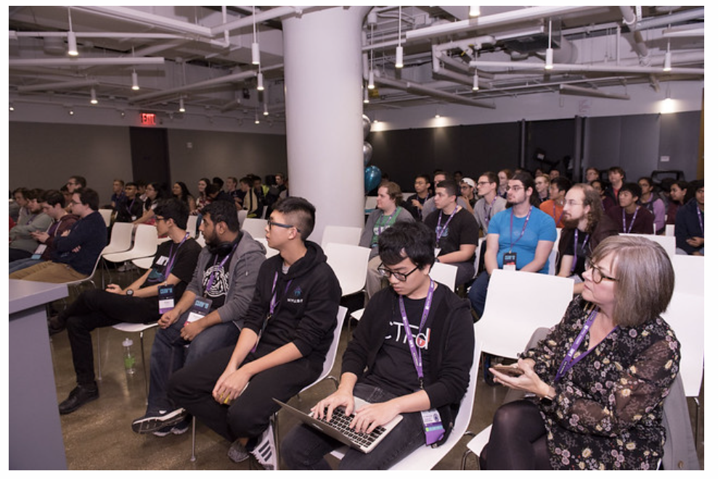
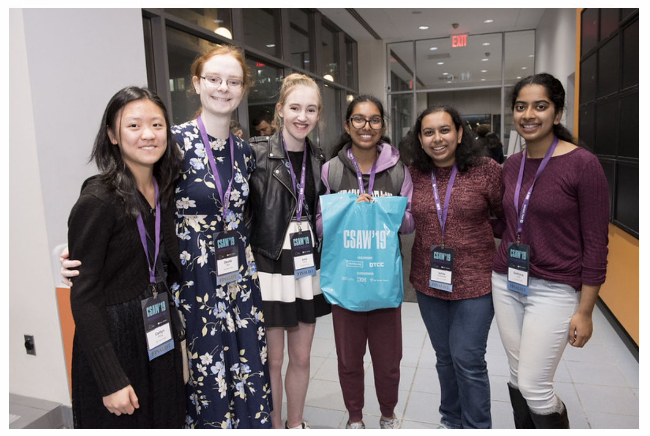
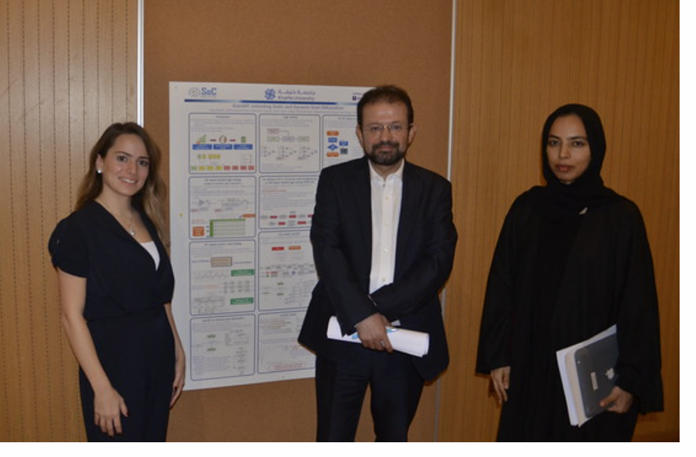
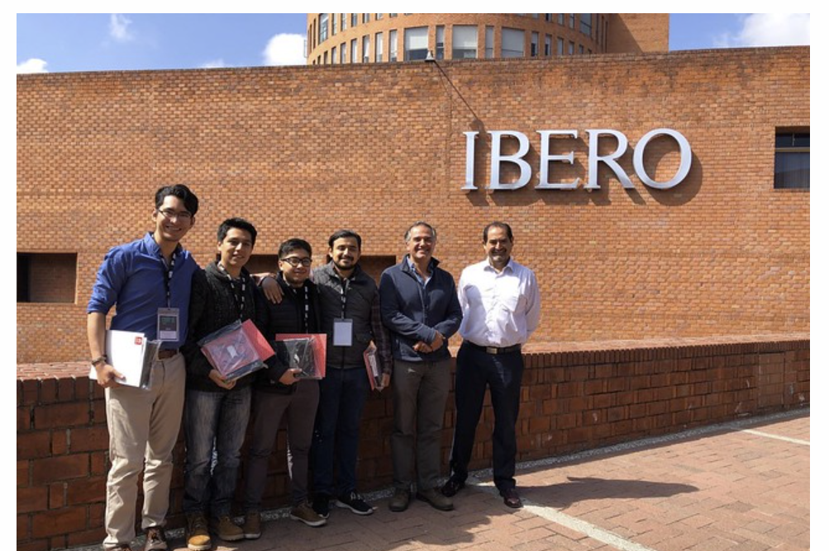
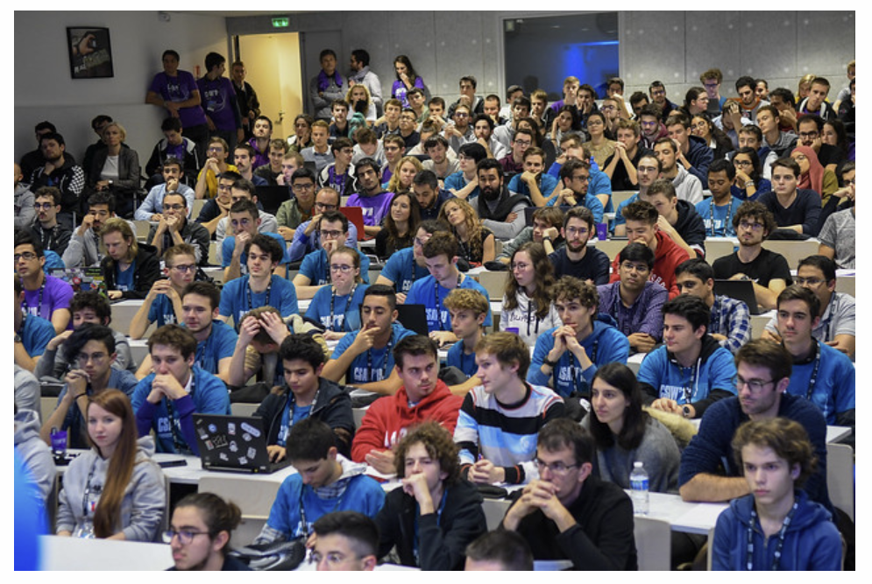
Task 4 – Cybersecurity Games & Conference (CSAW)
Year | 2020 | 2021 | 2022 | 2023
Venues | Virtual | Virtual | In-person | In-person
# of Competitions | 8 | 9 | 10 | 11
Regions | EU. India, Israel, MENA, Mexico, US-CAN | EU. India, Israel, MENA, Mexico, US-CAN | EU, India, MENA, US-CAN | EU, India, MENA, Mexico, US-CAN
Notes:
Regarding competitions, the CSAW event is now in its 20th year. It began as a small local competition but has expanded over the course of the Trust-hub project to 5 global academic centers with multiple annual cyber competitions. Some pictures from the NYU, EU, Mexico, India, and Middle East and North Africa events are shown at the bottom of this slide.
During this final iteration of the Trust-hub project, there have been 3 events with the 4th occurring this week!
Due to Covid, 2 of these events were organized remotely. Something about attendance numbers…

Slide 8
Acknowledgements
Top Trust-Hub Community Contributors
Dr. Sohrab Aftabjahani, Intel
Dr. Navid Asadi, University of Florida
Dr. Fatemeh Ganji, Worcester Polytechnic Institute
Dr. Farimah Farahmandi, University of Florida
Dr. Hassan Salmani, Howard University
Dr. Shahin Tajik Worcester Polytechnic Institute
Dr. Damon Woodard, University of Florida
National Science Foundation and PMs
Dr. Almadena Chtchelkanova (CI-ADDO-NEW)
Dr. Nina Amla (CI-EN)
Dr. Marilyn McClure (CCRI: ENS)
Notes:
And that is a summary of our project.
Before ending, I’d like to acknowledge Trust-hub’s top contributors from the community as well as the support from NSF and its PMs - Almadena, Nina, and Marilyn.
Thank you so much for giving us the opportunity to have such a large impact on the hardware security and trust community.

