Slide 1
DISCOVER
Distributed Sensing & Computing
Over Sparse Environments
Presented for
NSF PI Meeting
November 6-7, 2023
Presented by
Morgan Vigil-Hayes, PhD
Co-PI; NAU

Slide 2
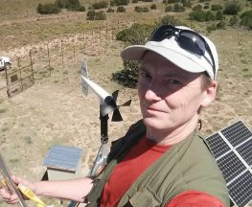
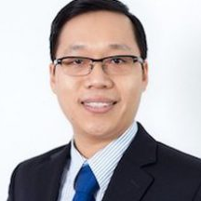
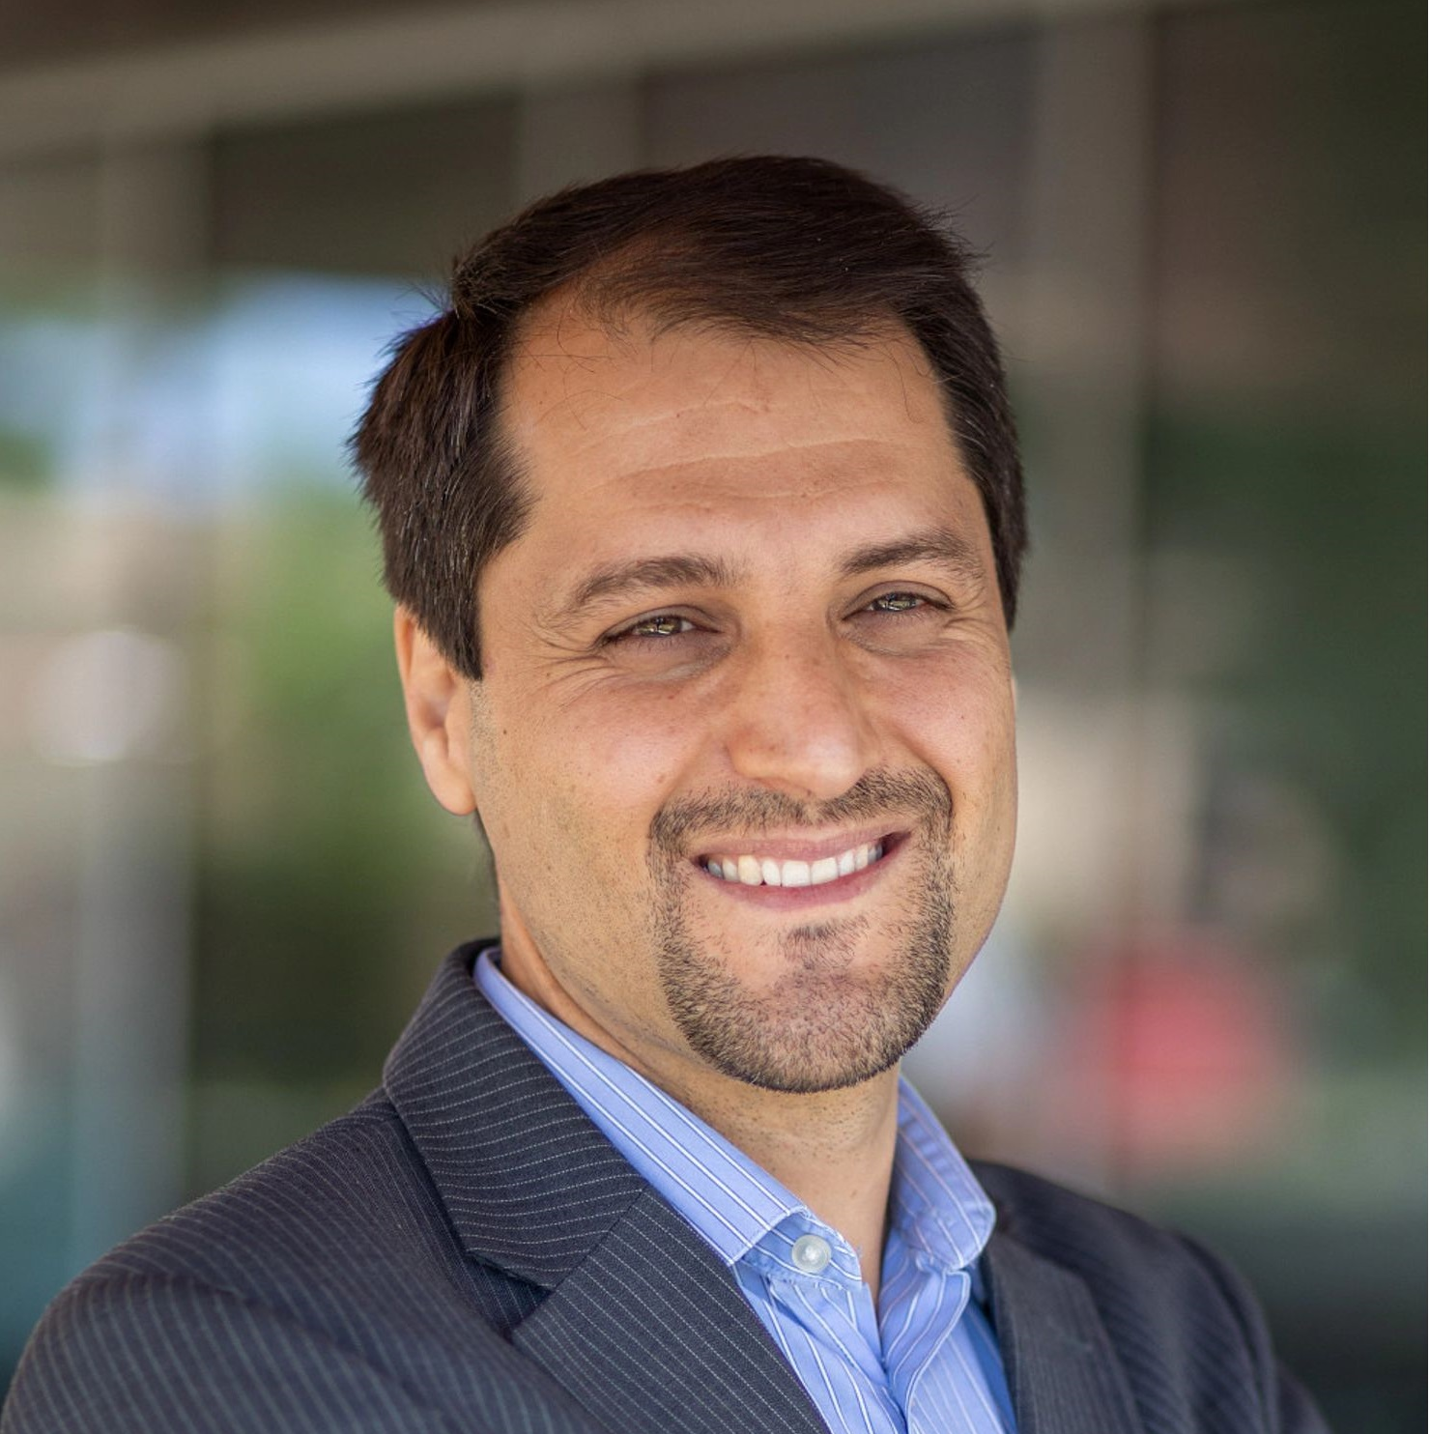
Key Personnel
Paul Heinrich
Lead PI
NAU
Truong Nghiem, PhD
Co-PI
NAU
Morgan Vigil-Hayes, PhD
Co-PI
NAU
Fatemeh Afghah, PhD
Co-PI
Clemson
Abhishek Roy Choudhury, PhD
Co-PI
NTU
Abolfazl Razi, PhD
Co-PI
Clemson

Slide 3
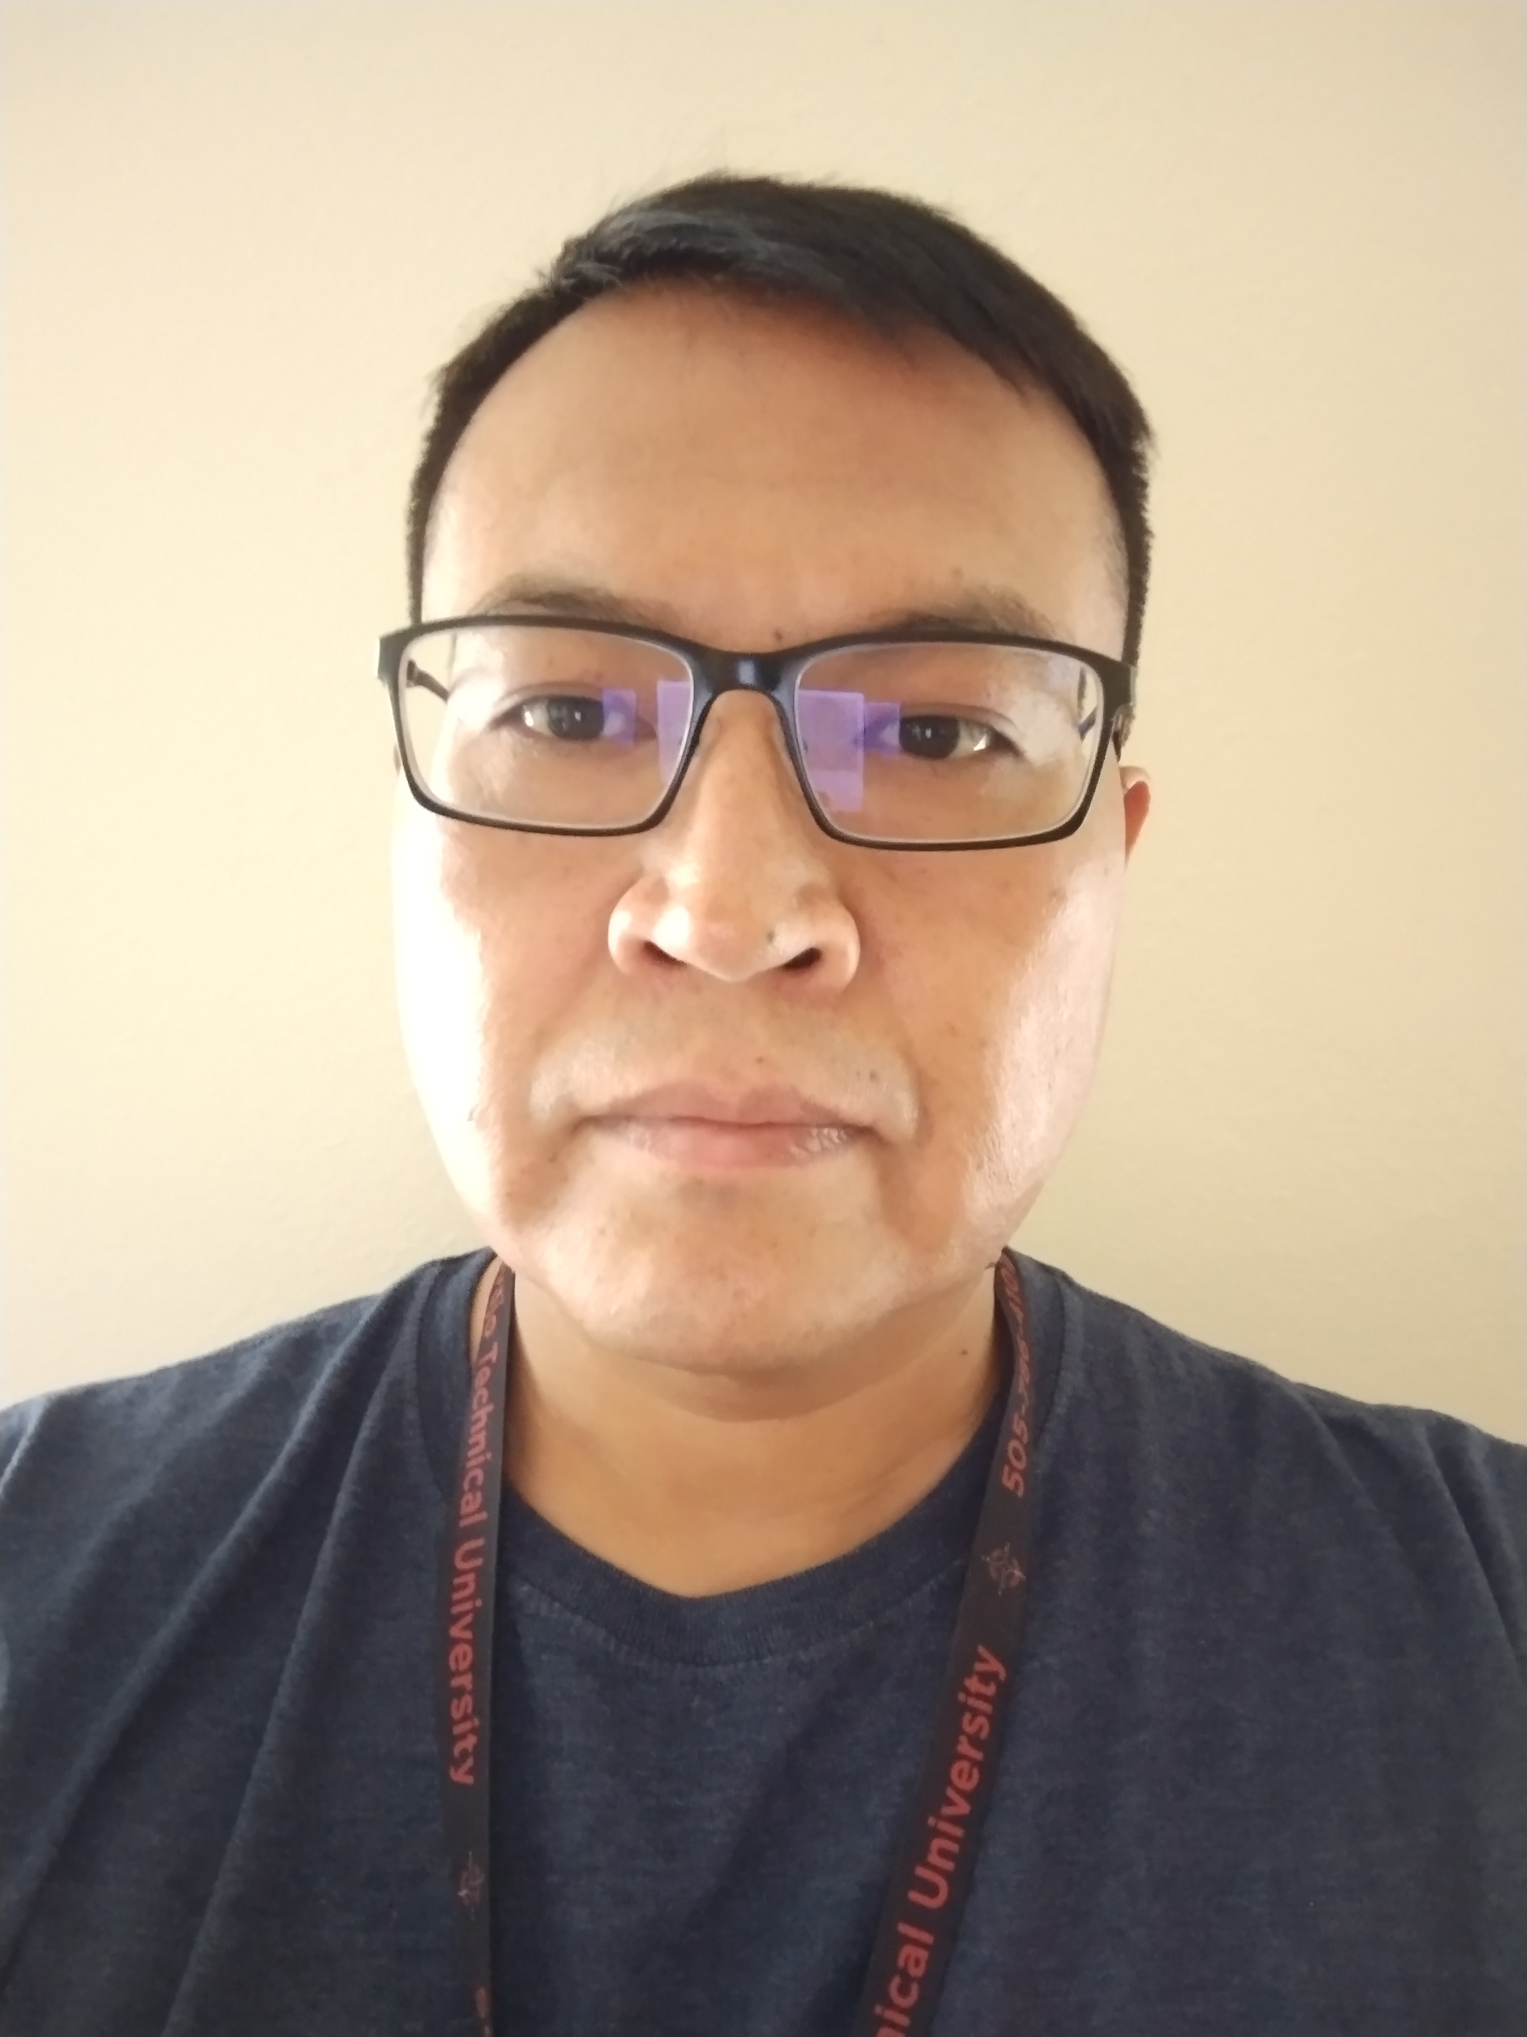
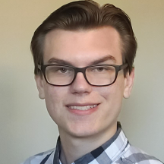
Key Personnel
Adrian Nez
Undergraduate Student
NTU
Nhat Linh Nguyen
Undergraduate Student
NAU
Bryce Hopkins
Graduate Student
Clemson

Slide 4
Overview
DISCOVER Overview
DISCOVER Sites
DISCOVER Infrastructure
What can I do with DISCOVER?

Slide 5
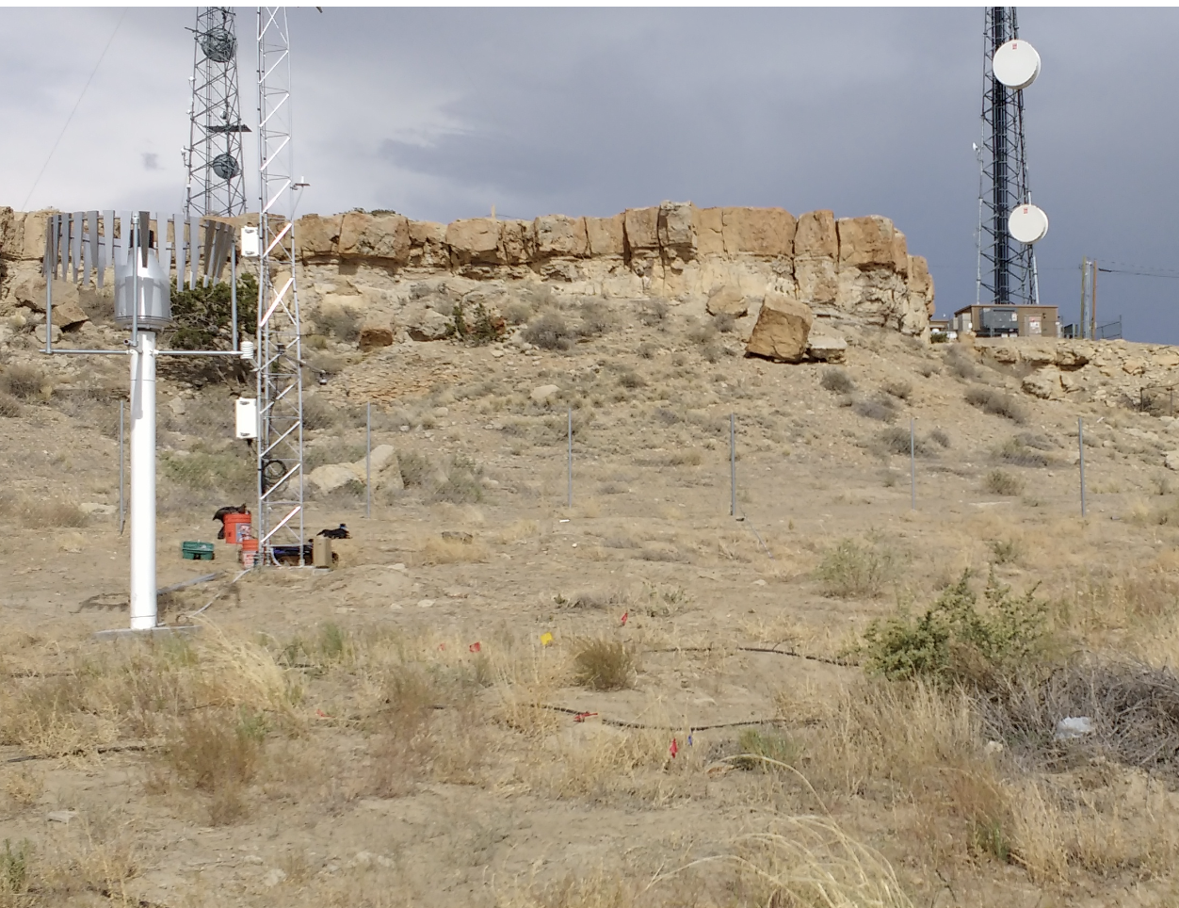
DISCOVER, est. 2021
What is DISCOVER?
NSF CISE Community Research Infrastructure that seeks to support research that investigates:
Distributed sensing & actuation
Distributed computing
Networking
In rural and challenging environments.
Free and open to all researchers and students with CILogon credentials
Example of sparse environment provided by DISCOVER

Slide 6
DISCOVER Vision & Objectives
Create a distributed testbed facility for CISE researchers to explore challenges and develop innovations in wirelessly-networked distributed sensing, actuation, and computation for applications in rural, remote, and underserved regions.
Sites will be equipped with fixed IoT nodes and experiment-specific deployments of terrestrial robots and aerial drones
Experimenters will be able to plan/deploy experiments and use rich datasets for research in a broad range of areas, including federated learning, multimedia networking, control systems and security

Slide 7
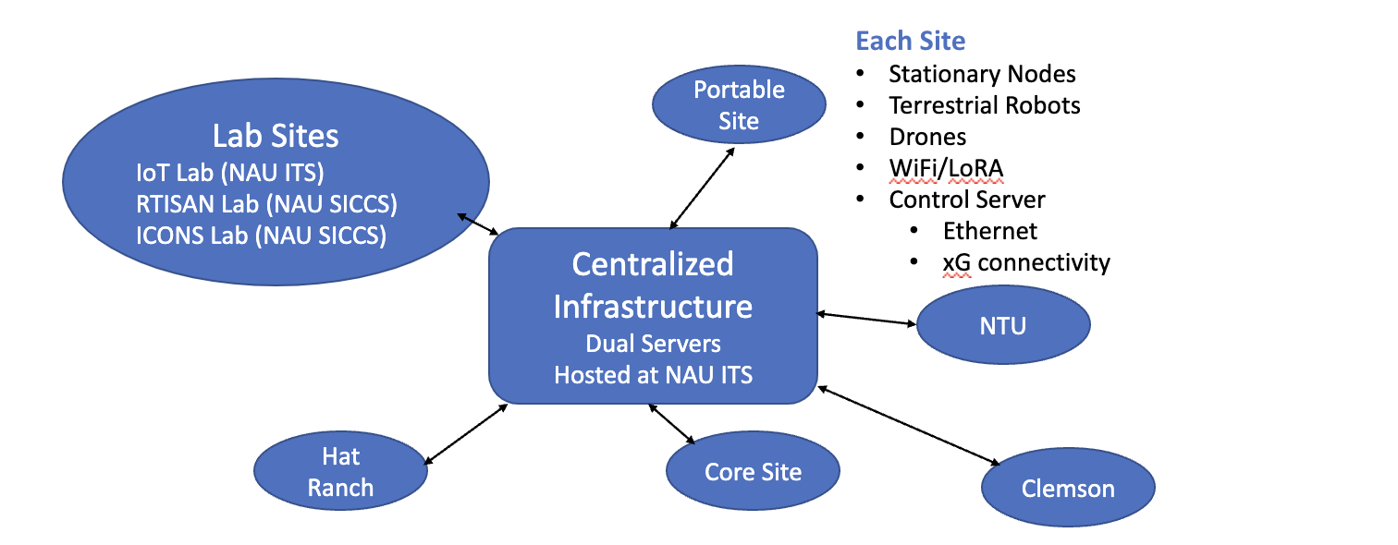
DISCOVER Sites
Sites provide a variety of environmental challenges to support a multitude of experimental scenarios

Slide 8
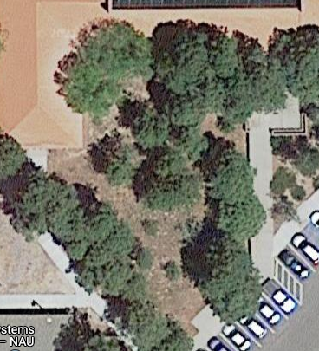
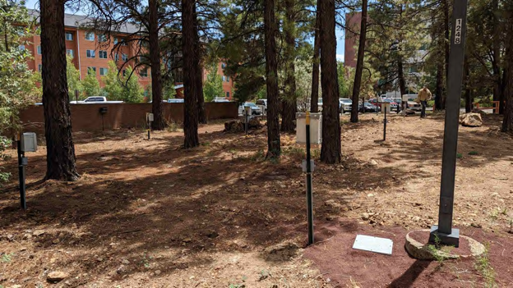
NAU Core Site
NAU Core Site
Approx. ¼ acre of forest land
Immediate access from ITS IoT Lab and NAU CS and ECE Labs
On-site storage, power, and network access
SICCS
ITS

Slide 9
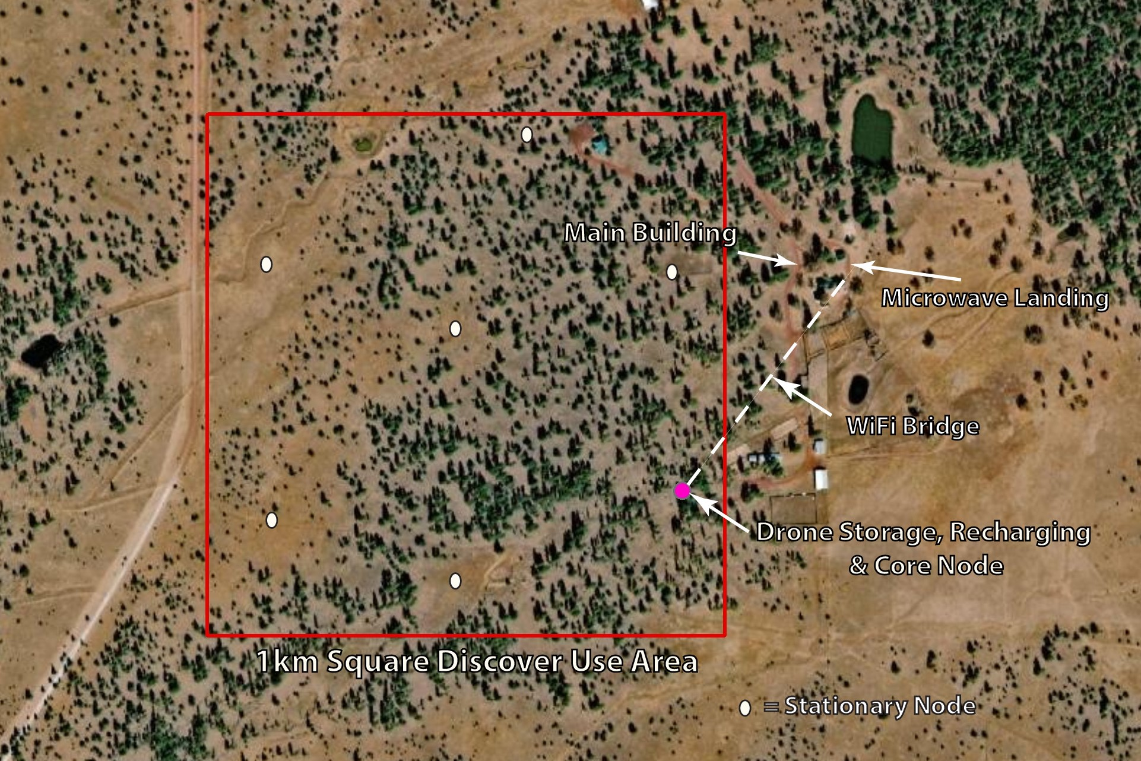
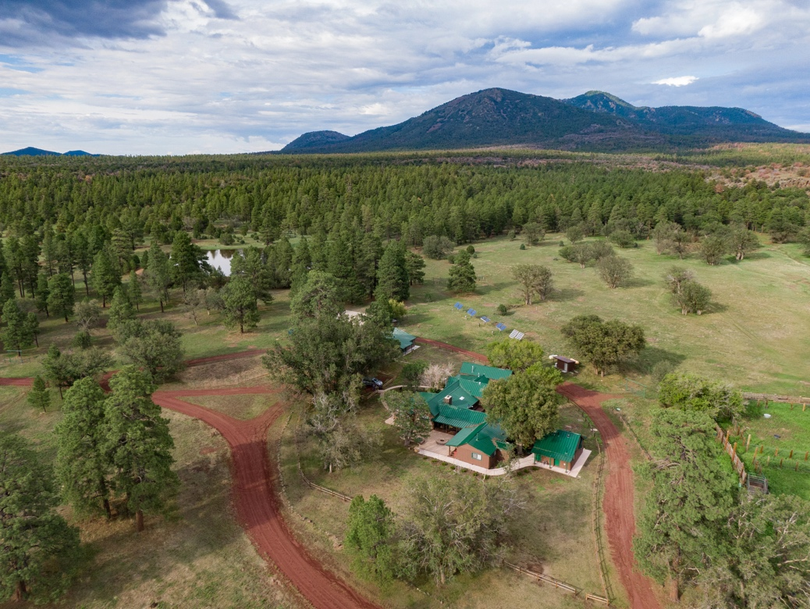
Hat Ranch Site
~300 acres - open and forested
On-site storage and power access
LTE Cell service (5G planned)
Enables evaluation of network sparsity effects

Slide 10
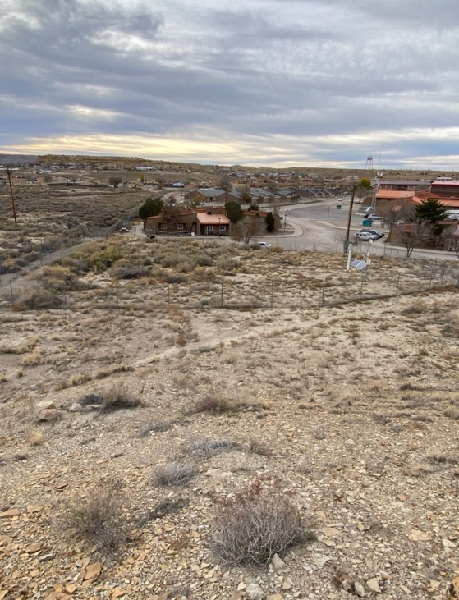
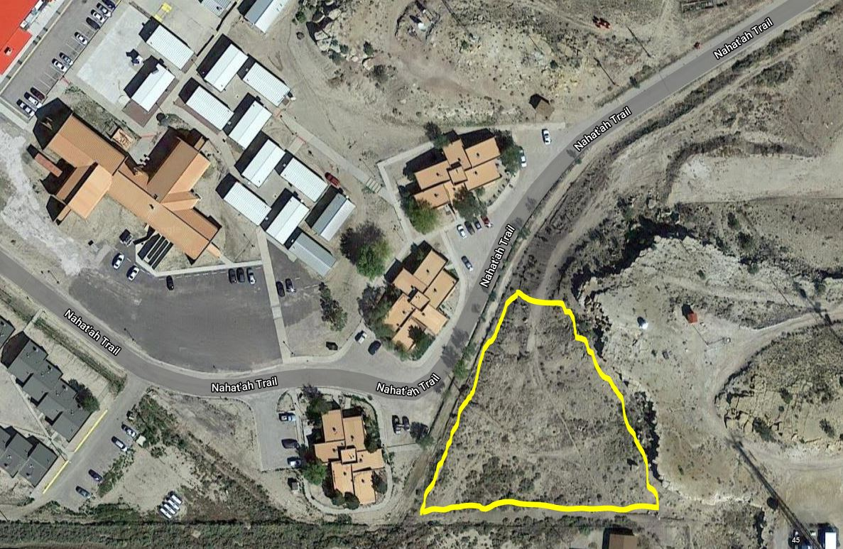
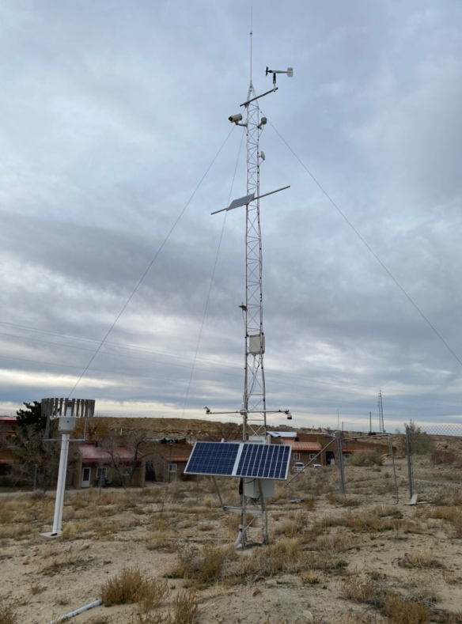
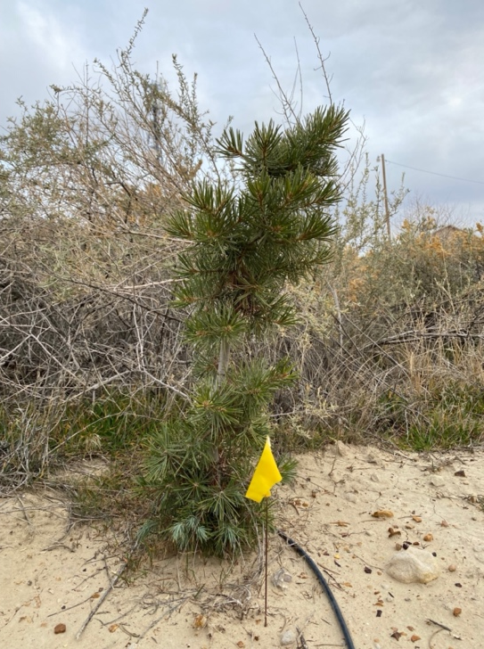
NTU Site
Approx. 1 Acre of Desert Grassland / Pine Seedling Plantation
Immediate Access from NTU Science Building with 5' fence
Solar Power (100W 400A-Hr), and Network Access
SICCS
ITS

Slide 11
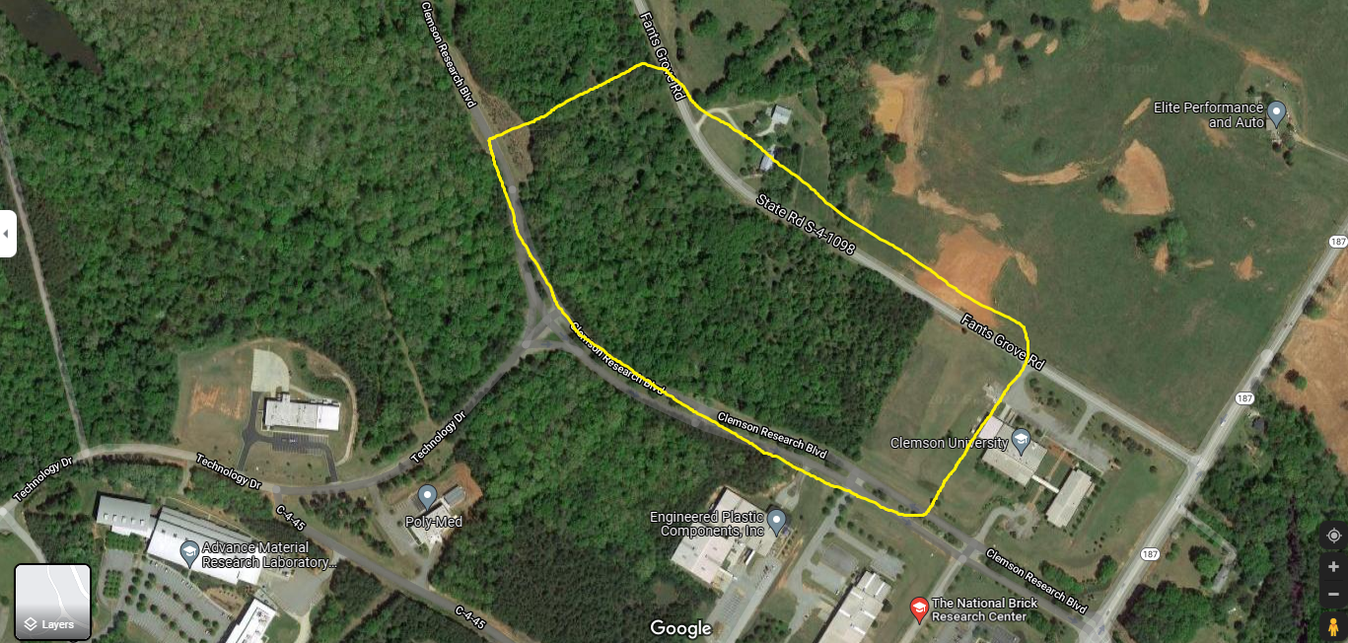
Clemson Site
Four acres of open, flat land
Seven acres of wooded land
On-site storage and power access available
Flight Test for Coverage Mapping, Exploring Possibilities with Clemson ITS for Extended Coverage, including Rooftop AP with Directional Antenna [Limit 30dB], and Meshed AP, Exploring other technologies such as LTE-hot-spotting
Clemson Advanced Materials Research Park, Anderson, SC (10 miles to main campus)​

Slide 12
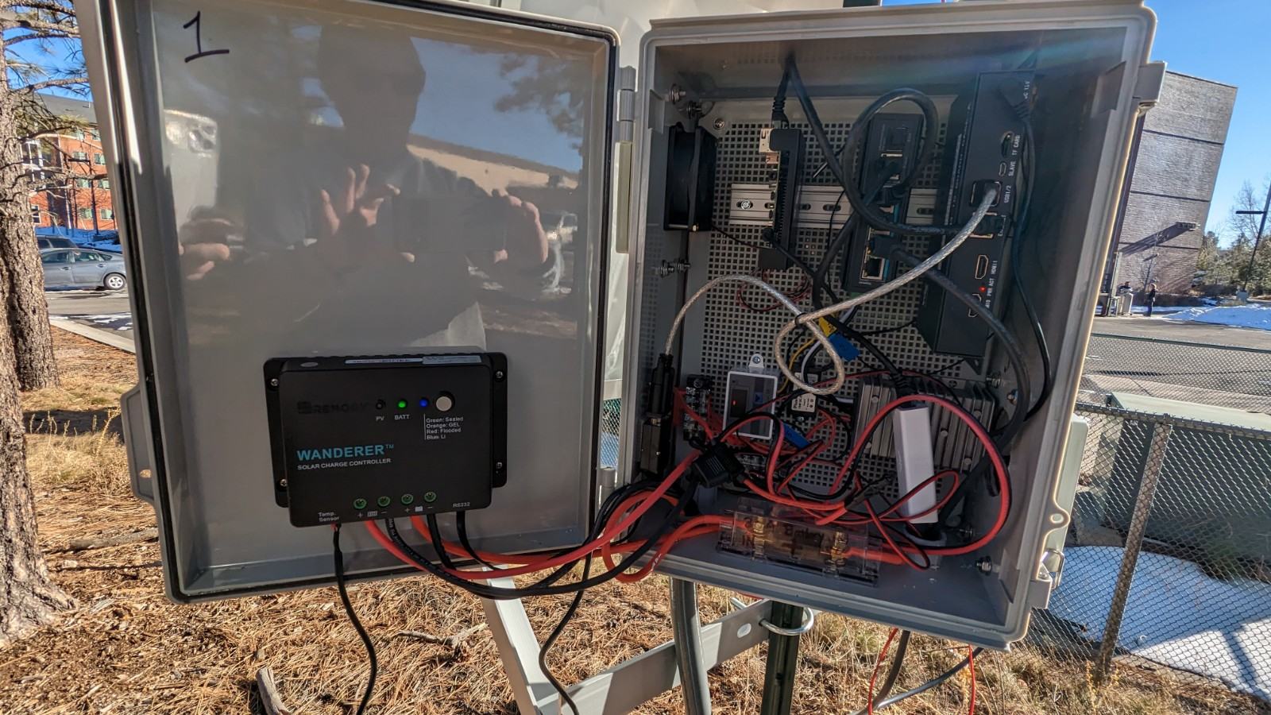
DISCOVER Infrastructure
Stationary Nodes
Ruggedized Raspberry Pi 4 Module B’s enable grid and solar-powered in-situ sensing and computational functionality for experimenting with distributed computation a variety of environmental data sensors and network capabilities.
Raspberry Pi 4 Model B
Seeed Studio SenseCAP S1000 weather station
DrLiu SDI-12
Meter Teros 12 soil sensor
Meter Teros 21 soil sensor
100K 3950 Ohm NTC Thermistor Temperature Sensor Probe​
Waveshare Environmental Sensor Hat​

Slide 13
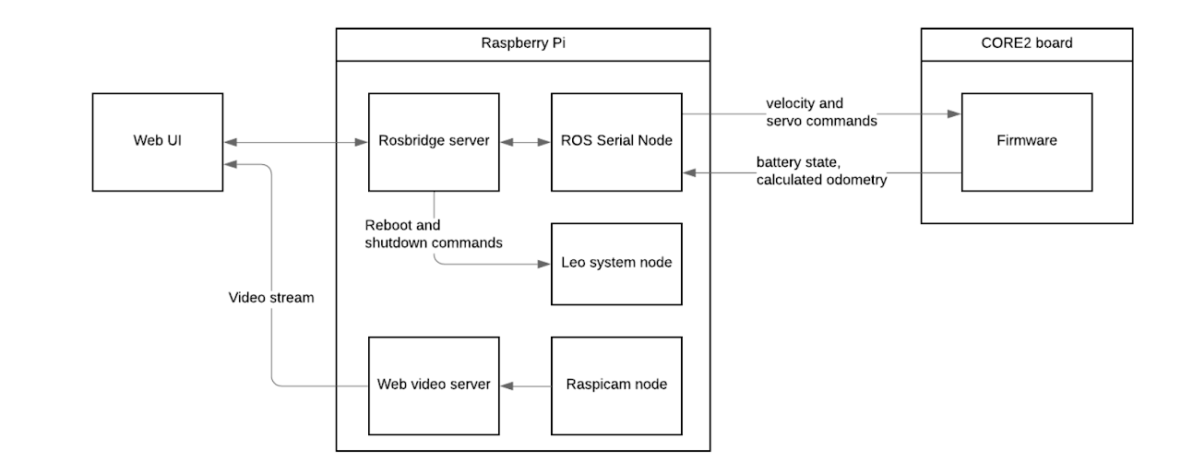
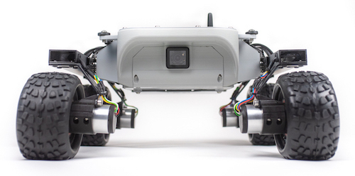
DISCOVER Infrastructure
Terrestrial Robots
Leo Rovers outfitted with camera, lidar, high-precision GPS, LoRa, and WiFi enable experiments carrying out mobile actuation and system control in challenging terrain.
PHOTO

Slide 14
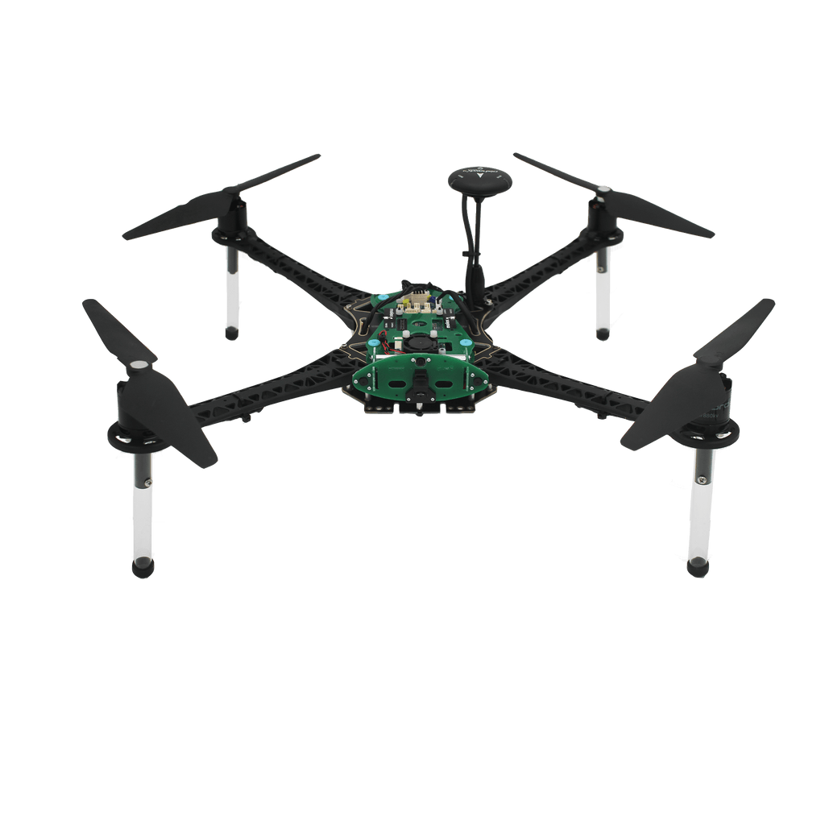
DISCOVER Infrastructure
Aerial Drones
Aerial drones enable experiments with federated coordination tasks between highly mobile aerial nodes and ground stations using heterogeneous networking and distributed computing.
25-minute flight time with 1 kg of payload
Visual obstacle avoidance
Visual inertial odometry
Native ROS1 and Docker support
Multiple autonomous flight modes
Enhanced with centimeter-grade GPS for outdoor flight
PHOTO
Modolai VOXL m500 Quadcopters

Slide 15
DISCOVER Infrastructure
Site | Status
NAU Core Site | Live 06/2023
Hat Ranch Site | Going Live 01/2024
NTU Site | Going Live 01/2024
Clemson Site | Going Live 01/2024

Slide 16
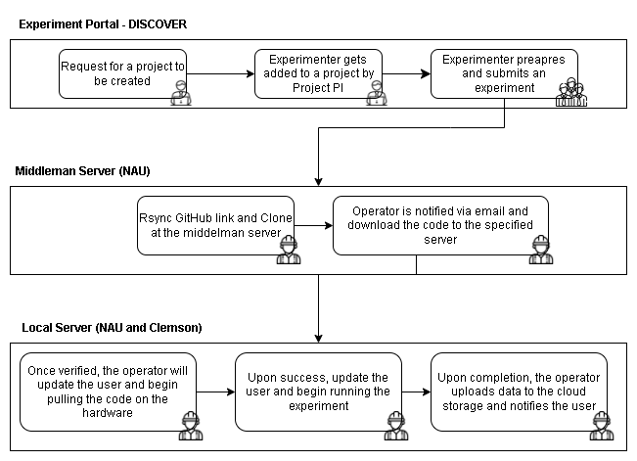
Experimenter Web Portal

Slide 17
What can you do with DISCOVER?
DISCOVER enables experiments and simulations in rugged environments.
Examples include:
Use multiple mobile agents to recon a wildfire
Make predictions on sparse environmental data collected from multiple points across forest, desert, and grassland landscapes
Test network protocols in sparse environments with mobile and stationary nodes and multiple data links
PHOTO

Slide 18
Thank You!
www.discoverccri.org
DISCOVER is funded by NSF award #2120484.

